Slide 1
Mini project 1 development plan moh fahb hasan

Slide 2

Fahb's coffee shop

Slide 3
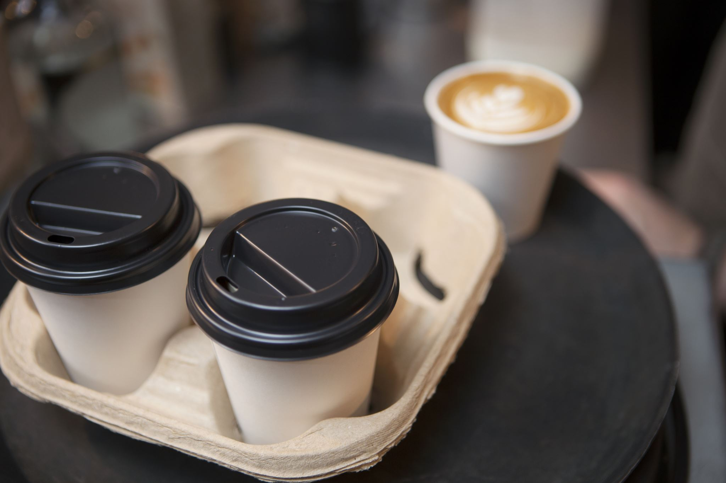
MINI PROJECT 1 PROPOSAL
Topic: ”Coffee Shop”
Project: Local Coffee Shop
Company Tagline: ”Where Coffee Unites.”
Organization Background: Fahb’s Coffee Shop is a beloved local destination where coffee meets community. With a dedication to exceptional quality and a welcoming atmosphere, Fahb's has become a cherished hub for coffee enthusiasts and connections alike. Our commitment to creating a warm space for all is at the heart of our journey.

Slide 4

Purpose and Target Users:
Purpose: At Fahb's Coffee Shop, our purpose is to provide a cozy and inviting space where people can enjoy premium coffee while fostering meaningful connections within the community.
Target: We cater to coffee aficionados, students, professionals, and anyone seeking a comfortable environment to relax, work, and socialize

Slide 5

Site map

Slide 6
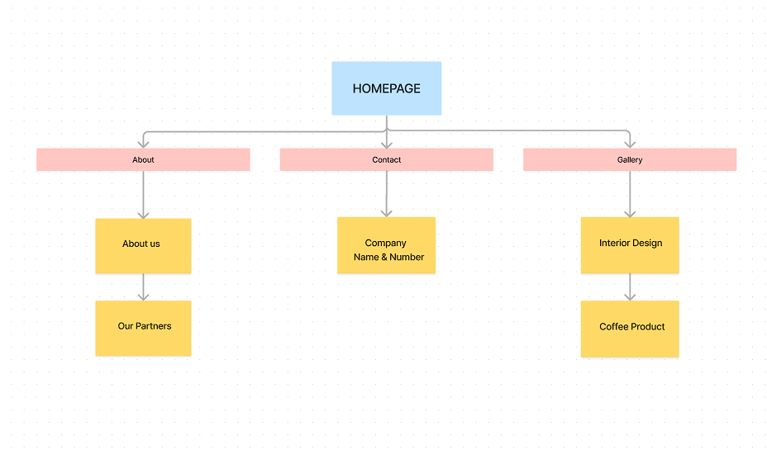

Slide 7

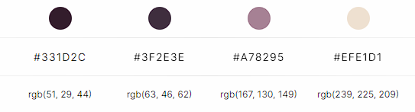
Color Palette

Slide 8
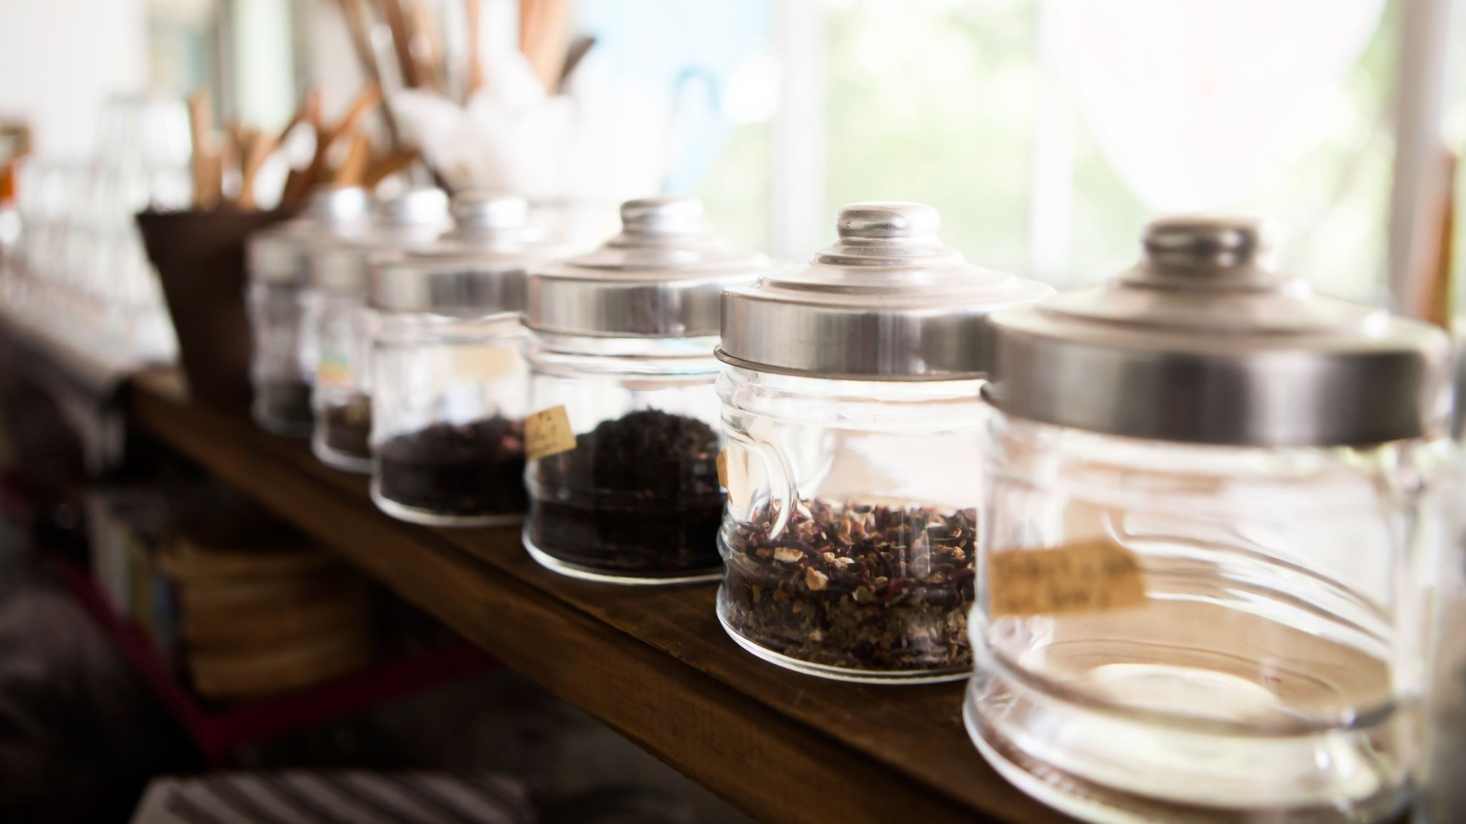
Wireframe

Slide 9
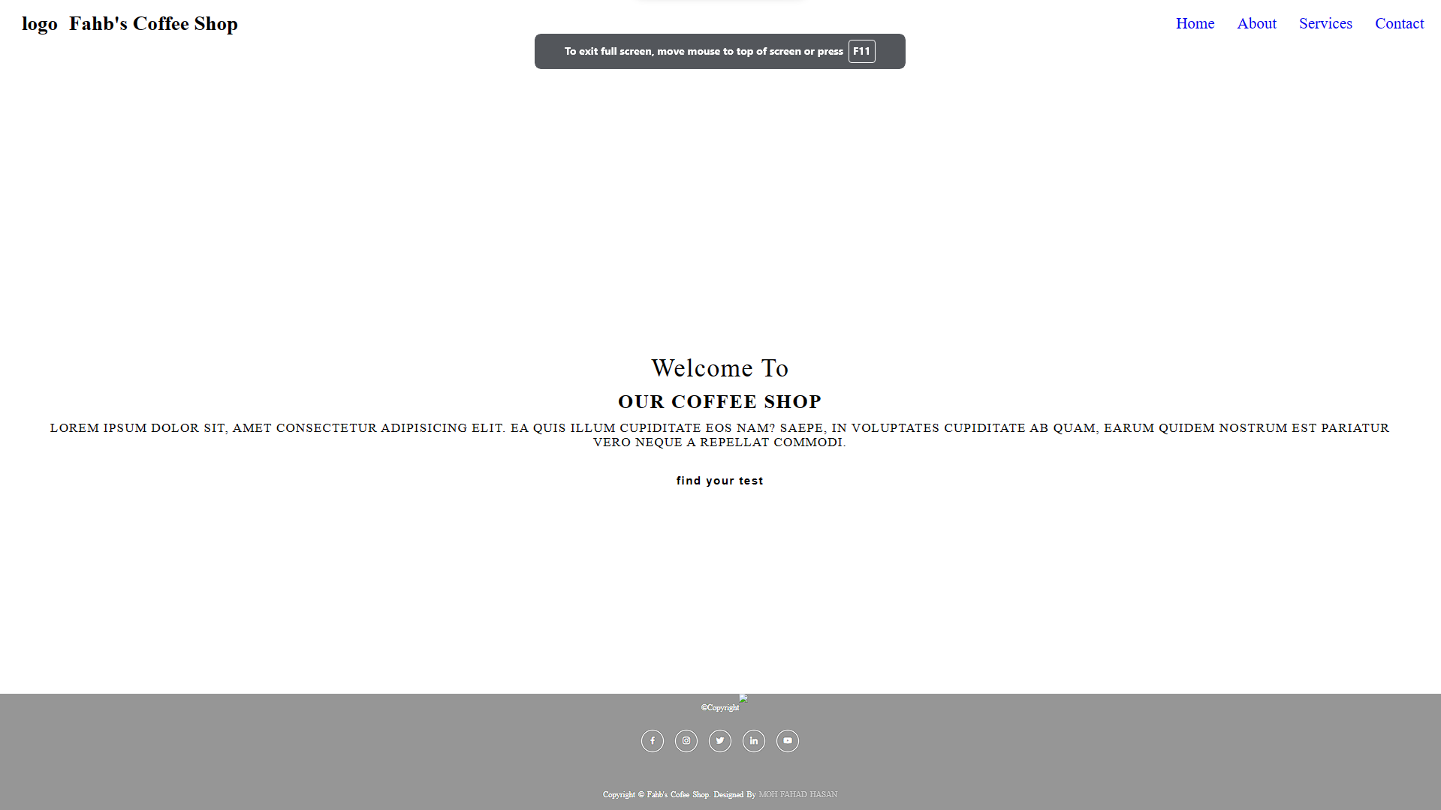

Slide 10
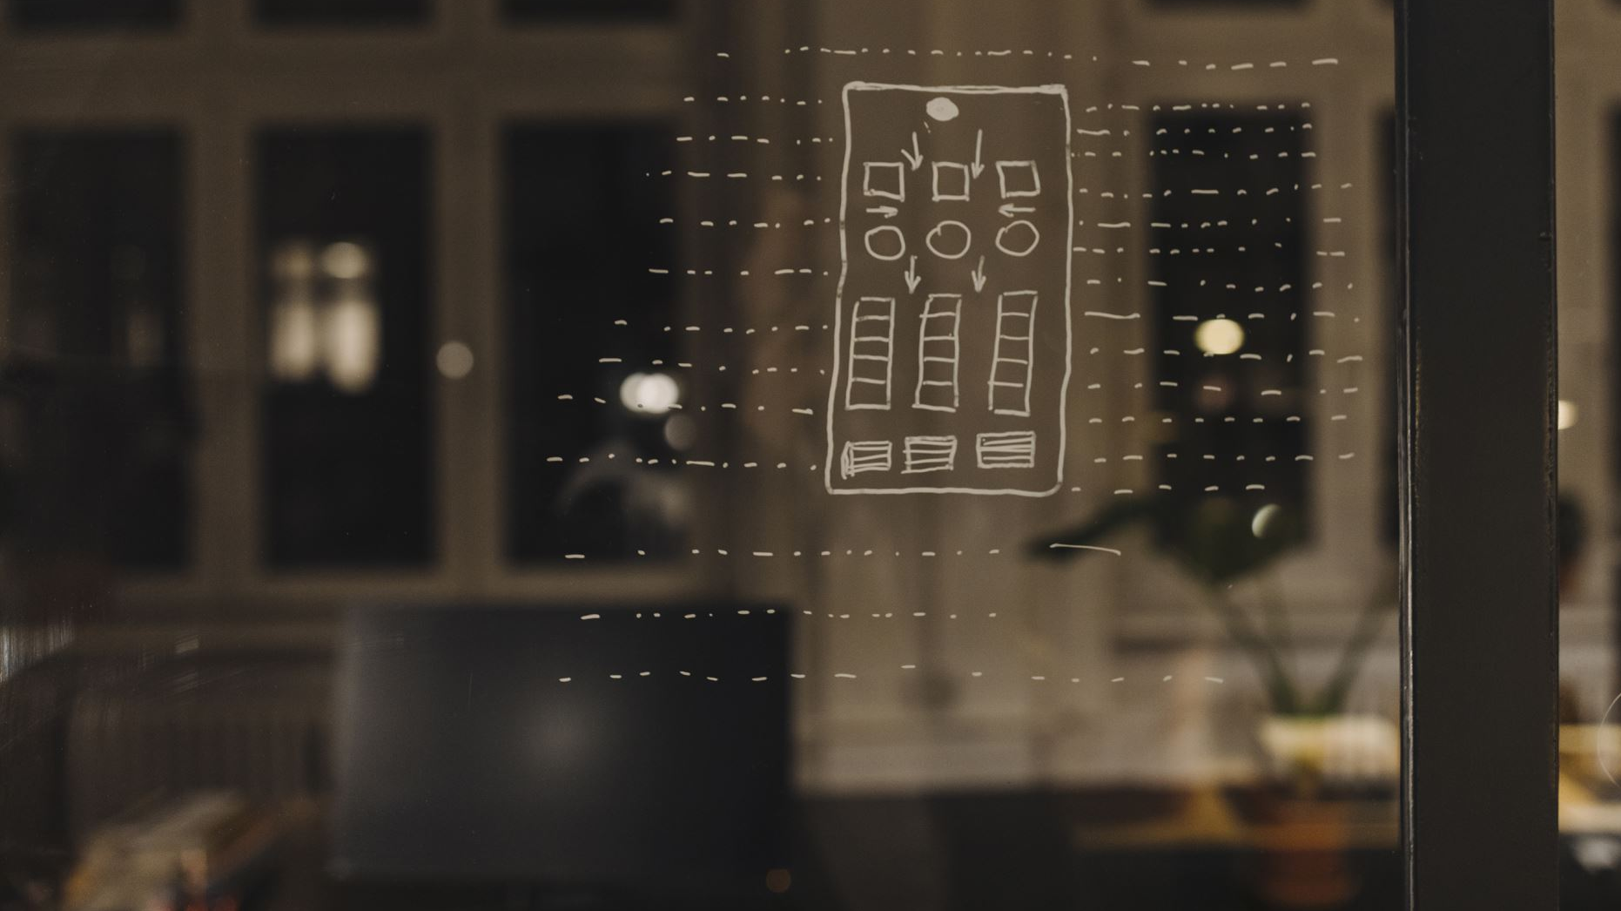
goals
Engaging User Experience:
● Design a user-friendly website layout that offers easy navigation and quick access to menu items, location details, and contact information.
Visual Appeal:
● Incorporate appealing visuals, such as high-quality images of your coffee creations, interior ambiance, and team, to showcase the essence of Fahb's Coffee Shop.
Mobile Responsiveness:
● Ensure the website is fully responsive and optimized for mobile devices, providing a seamless experience for customers on smartphones and tablets.

Slide 11
Menu Showcase:
● Display an up-to-date and visually appealing menu section with detailed descriptions of beverages, snacks, and specials offered at the coffee shop.
Customer Reviews and Testimonials:
● Showcase positive customer reviews and testimonials prominently on the website to build trust and credibility among potential customers

Slide 12

Thank you!
"Coffee: Because sleep is for the weak."
Fahb Hasan 2023

